Slide 1

Regression Analysis
Notes:
‹#›

Slide 2
Agenda
What is regression analysis?
How does regression analysis work?
Different regression algorithms.
When to use regression analysis?

Slide 3
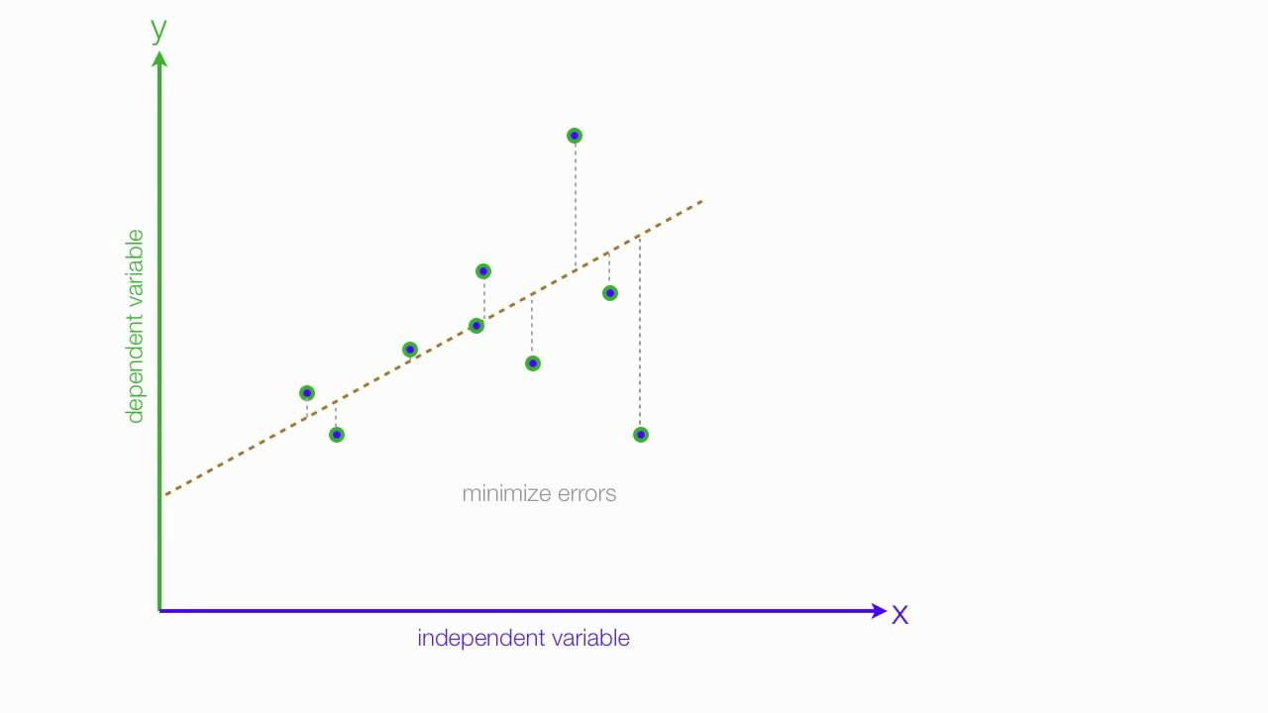
What is Regression Analysis?
Methodology that consists of machine learning algorithms that predict a continuous variable, rather than a class.
Can make the prediction based on multiple independent variables.
Objective: create a mathematical model that represents the dependent variable, y, as a function of the independent variable, x.

Slide 4
How Does Regression Analysis Work?
A mathematical model is created to identify a relationship between an independent variable and a dependent variable.
When the mathematical model is applied to a dataset, a relationship between the dependent variable and independent variable is identified and will then be used on new data.
Different regression algorithms can be used to find the best relationship between dependent and independent variables.
The goal is to minimize error in predicting the continuous value of the dependent variable.

Slide 5
Different Regression Algorithms
Linear regression.
Polynomial regression.
Decision trees.
Random forest.

Slide 6
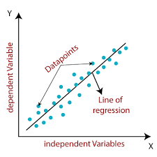
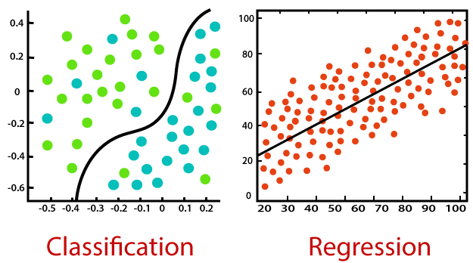
When to Use Regression Analysis?
Regression analysis should be used when the objective is to predict a continuous dependent variable from one or more independent variables.
In simple terms, if you want to predict a continuous outcome, variable y, based on the value of variable x, use regression analysis.

